Slide 1
Marketing Specialist
Will Dodd
Marketing Case Study

Slide 2
The People.
High Net Wealth Individuals
Millennial / Gen Z
Women
Mass Affluent
Pre-Retirees / Retirees
Notes:
Other Wealth Management firms with higher engagement use video in their social media mix

Slide 3
The Message.
Wealth Preservation and Risk Management
Tax Optimization and Estate Planning
Personalization and Digitally Enhanced Services
Access to Alternative Investments
Sustainable and Impact Investing
Notes:
Other Wealth Management firms with higher engagement use video in their social media mix

Slide 4
The Platforms.
54%
34%
Come from households earning over $100,000 annually (Link)
UHNWIs report regular use of Facebook (Link)
73% use LinkedIn to research and make financial decisions (Link)
74% of high-income earners
< $75,000 use Facebook (Link)
25%
35%
UHNWIs report regular use of Instagram (Link)
UHNWIs report regular use of YouTube (Link) (Link 2)
83% of U.S. adults report using YouTube (Link)
Preferred for luxury exploration among 17 to 25-year-old affluent consumers (Link)
Notes:
Other Wealth Management firms with higher engagement use video in their social media mix

Slide 5
The Topics.
3 Tax Optimization Strategies HNW Families Can’t Afford to Ignore in 2025
Highlights from Our Client Appreciation Dinner in Austin
How Today’s Wealthiest Investors Are Allocating to Alternatives
How We Gave Back This Quarter: Bronco Financial in the Community
Behind the Firm: Our Approach to Multi-Generational Wealth Preservation
How a Colorado Family Secured Their Legacy Through Strategic Planning
Notes:
Other Wealth Management firms with higher engagement use video in their social media mix

Slide 6
The Topics.
Explaining Estate Planning with Real Examples: What HNW Families Need to Know
Wealth Preservation
Legacy Planning
Alternative Investments
Digital Experience
Liquidity Management
Family Governance and Education Philanthropy
Charitable Giving Succession
Planning for Business Owners
3 Things We Learned from Managing $100M in ESG Portfolios
What to Ask a Wealth Manager Before You Invest
Notes:
Other Wealth Management firms with higher engagement use video in their social media mix

Slide 7
The Message.
Retirement Security & Longevity Planning
Confidence in Financial Decision-Making
Desire for Personalized and Empathetic Advisory Relationships
Holistic Wealth Planning
Interest in ESG and Impact Investing
Notes:
Other Wealth Management firms with higher engagement use video in their social media mix

Slide 8
The Platforms.
30%
56%
Of US women use LinkedIn (Link)
Women have $3M +in liquid assets (Link)
34% of individuals earn between $70,000 and $99,000 (Link)
70%, 37%, 18% report regular philanthropic giving to various causes (Link)
?
54%
90%
Users are female (Link) BUT…
Of all users hold a college degree (Link)
Only 2.6% of Snapchat users are women over 50 (Link)
86% of U.S. adult users have HHI <$100k⁺ (Link)
Notes:
Other Wealth Management firms with higher engagement use video in their social media mix

Slide 9
The Topics.
What Financial Empowerment Looks Like for Women in Leadership
5 Questions Every Woman Should Ask Her Financial Advisor
From Paycheck to Portfolio: Investment Strategies for High-Earning Women
Retirement Planning for Women Who Don’t Want to Slow Down
What Happens to Your Wealth If You Outlive Your Spouse?
The Most Overlooked Financial Risk for Women
Notes:
Other Wealth Management firms with higher engagement use video in their social media mix

Slide 10
The Topics.
Women & Wealth: 3 Retirement Planning Mistakes to Avoid
71% of women now own investments in the stock market. Are you one of them?
Solo but Not Broke: Wealth Planning for Single Women
Your Take: Women and Wealth
I’m 30, Where Do I Start? Financial Planning by Life Stage
Glow Up Your Wallet: Tiny Habits That Build Wealth
What Are Gender-Lens Funds | Imposter Syndrome in Investing: Yes, You’re Qualified to Do This | Joint Accounts, Separate Goals: Investing as a Couple
Notes:
Other Wealth Management firms with higher engagement use video in their social media mix

Slide 11
Other Topics.
3 Tax Optimization Strategies Families Can’t Afford to Ignore in 2025
How Today’s Wealthiest Investors Are Allocating to Alternatives
Should I Pay Off Debt or Start Investing First
How to Build Wealth Without a Trust Fund
3 Personal Finance Books That Actually Changed My Mindset
Is It Okay to Care About the Planet and Your Profits?
And more…
Notes:
Other Wealth Management firms with higher engagement use video in their social media mix

Slide 12
Social Boost
🧠 Leveraging more educational content
📣 Boost Key Posts to Refined Audiences
🎥 Incorporate more videos
📅 Increase Posting Frequency
💬 Improve Call-to-Actions
🖼️ Upgrade Visual Consistency

Slide 13
"That company gets me."
Prestige
Private
Exclusive
Quiet power
Gourmet, not buffet
Guest list vetting
Iconic venues

Slide 14
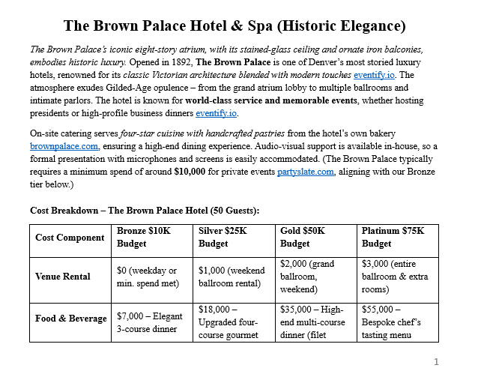
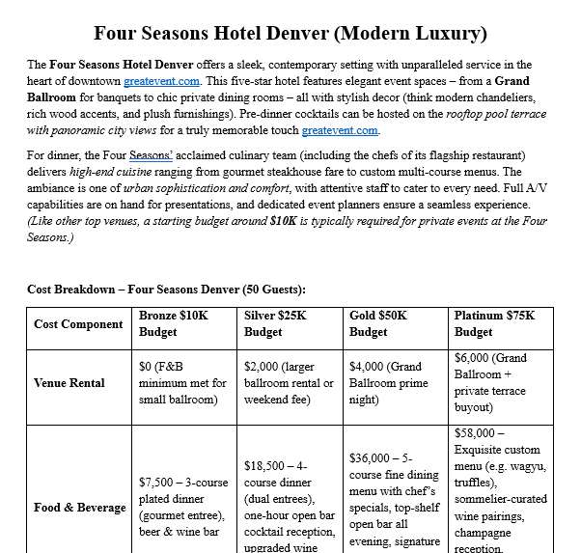
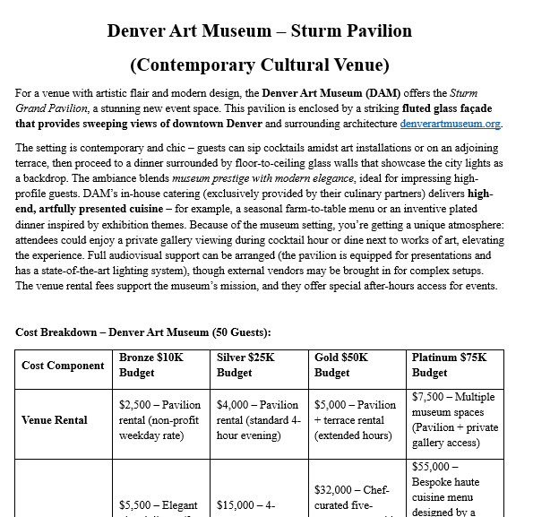
Elegant ambiance, exceptional cuisine, and full-service amenities
The Brown Palace Hotel & Spa
Pinnacle Club at Grand Hyatt
The Denver Art Museum
The Four Seasons

Slide 15
EVENT
The
“Strategies For Building Generational Wealth”

Slide 16
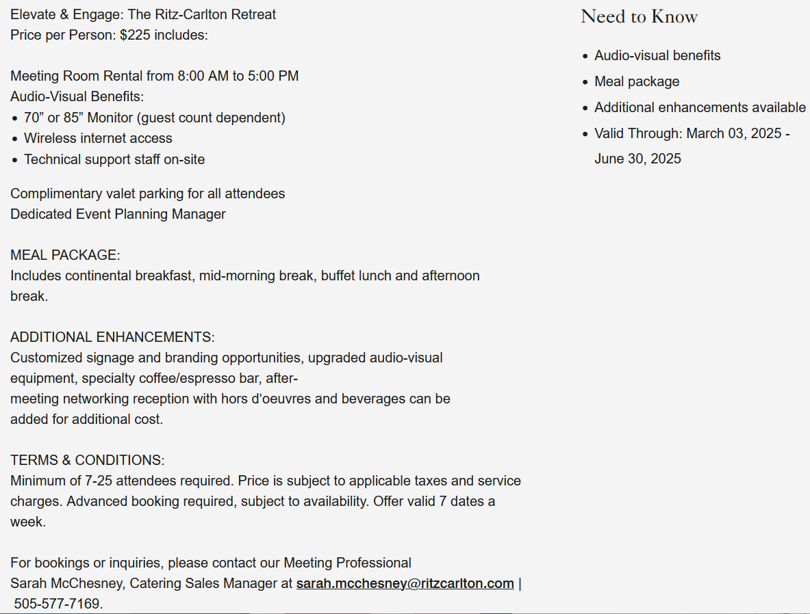
Elegant ambiance, exceptional cuisine, and full-service amenities
Valet Parking
Refined luxury
Elite service
Privacy
25 Guests ~ $15,000

Slide 17
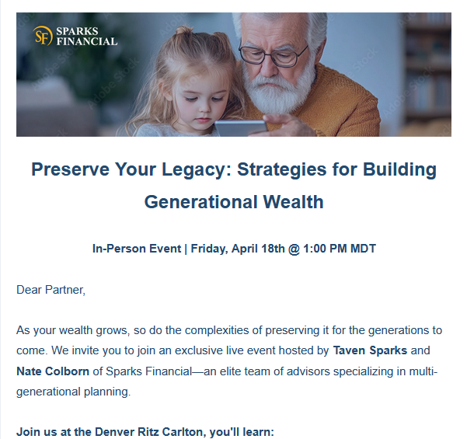
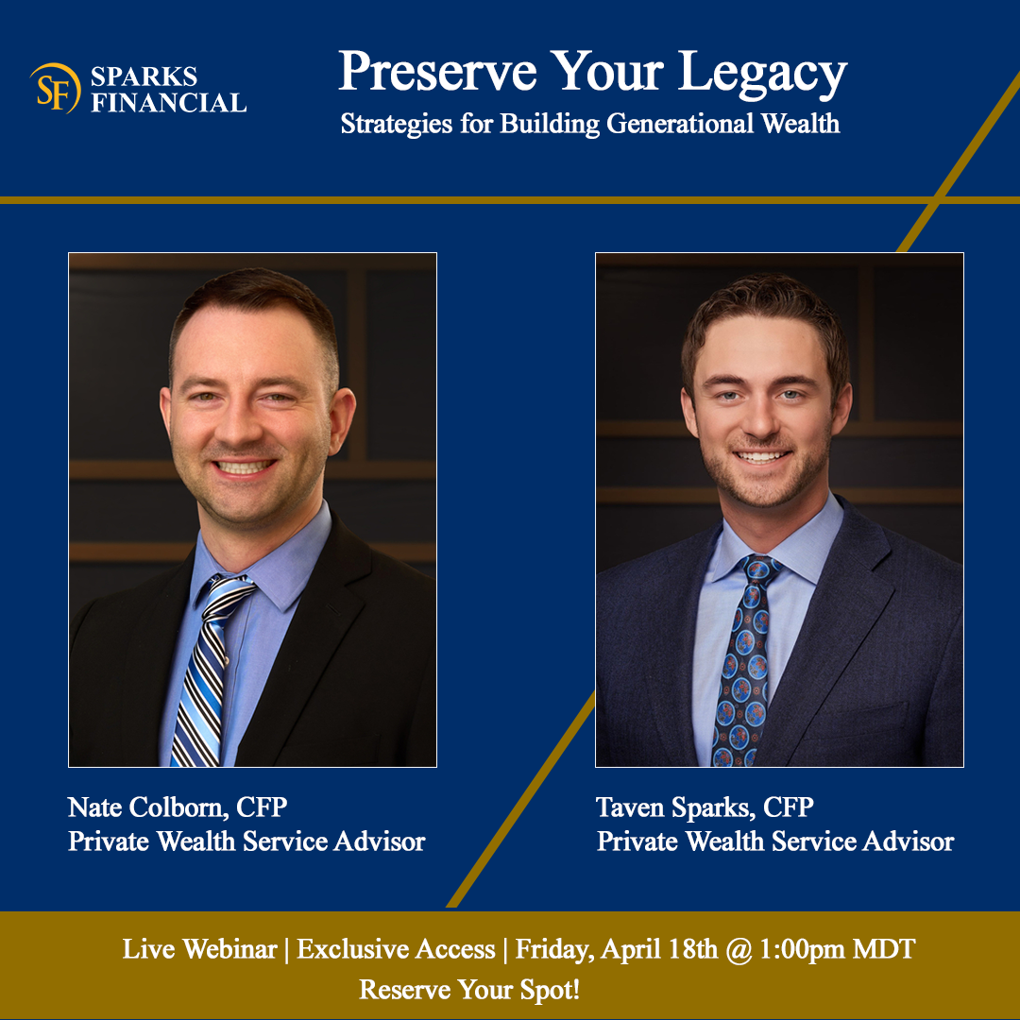
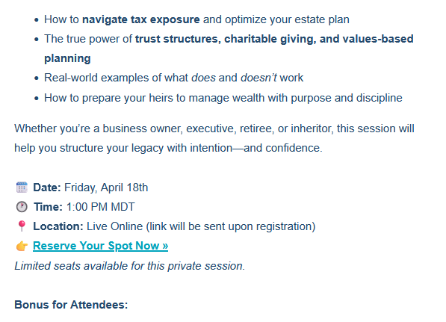
True legacy isn’t measured by what you leave behind—it’s defined by how well your family is prepared to receive it.
Join Taven Sparks and Nate Colborn of Sparks Financial for a high-level, expert-led webinar:

Slide 18
Click me

Slide 19
8-Week Event Timeline
Date | Task
5/5 – 5/11 | Finalize event theme / objectives. Secure venue / sign contracts. Confirm speakers. Design printed invitations. Draft email communications / landing page content
5/19 – 5/25 | Send 'Save the Date' emails. Launch event landing page with RSVP form. Engage catering services. Arrange valet parking. Discuss table settings / décor with decorators
6/2 – 6/8 | Mail printed invitations. Track RSVPs / follow up as necessary. Finalize menu selections. Approve table arrangement. Confirm valet parking logistics
6/16 – 6/22 | Send formal invitation emails w/ agenda and speaker details. Coordinate setup requirements with venue. Arrange audiovisual equipment / technical support
6/23 – 6/29 | Conduct venue walkthrough with vendors. Confirm final guest list and special requirements. Prepare event materials (programs, name tags, etc.)
6/30 | Oversee venue setup. Welcome guests / ensure event runs smoothly. Coordinate with speakers. Manage event schedule. Oversee breakdown / cleanup
7/1 - 7/7 | Email thank-you to attendees. Review event success against objectives.

Slide 20
The Drip Campaign
Subject | Body
Secure Your Legacy: Join Our Generational Wealth Webinar | Your wealth is more than numbers—it's your story, your values, and your legacy. Join us for an exclusive webinar, 'Strategies for Creating Generational Wealth,' hosted by Sparks Financial. Together, we’ll explore how to build a meaningful legacy, plan for your family's future, and give back to the causes that matter. You’ll also learn about the charities we proudly support and how philanthropy fits into financial planning. Reserve your spot today.
Why Planning for the Next Generation Starts Today | Did you know 70% of wealth transfers fail by the second generation? In our upcoming webinar, we'll share proactive strategies to help your legacy endure—and empower the next generation. Whether you're starting from scratch or refining your long-term plan, this session is packed with practical insights.
Meet Your Hosts: Taven Sparks & Nate Colborn | You’ll be joined by two of Sparks Financial’s most trusted voices: Taven Sparks and Nate Colborn. They bring decades of experience in holistic wealth planning and multigenerational legacy strategy. During the webinar, they’ll also spotlight charitable giving strategies and share how Sparks Financial actively supports community-based initiatives. You won’t want to miss this engaging and purpose-driven session.
And more…

Slide 21
Thank you!
True legacy isn’t measured by what you leave behind—it’s defined by how well your family is prepared to receive it.
Join Taven Sparks and Nate Colborn of Sparks Financial for a high-level, expert-led webinar:
I look forward to the opporunity to bring my skills and experience to the
Sparks Financial team.

